Slide 1
Wills and Trusts
Protecting
your inheritance
your wealth and
your loved ones

Slide 2
Our 3 Aims Today
To identify specific legal and financial problems
To provide advice in relation to your options and solutions
To provide guidance on how to get the right help and advice

Slide 3
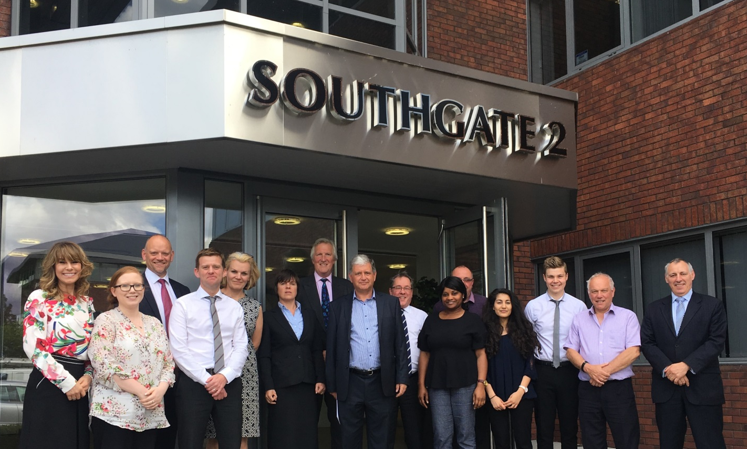
About Us – EPS team
The team
Notes:
Set the company up 15 years ago
to provide professional,
high quality estate planning advice
at a fair price
with excellent service delivery and customer service

Slide 4
About Us – Qualifications and Experience
15 years in business
35,000+ Wills and LPAs written
Specialists in Vulnerable Beneficiary protection
Notes:
Specialists
STEP Qualified = Gold Standard
IPW Means we are Regulated, Insured + follow a strict Code of Conduct
TSI More rules & Terms of Business – and its a good thing
Very experienced 10,000+ wills, 10,000 plus trusts and 15,000+ LPAS

Slide 5
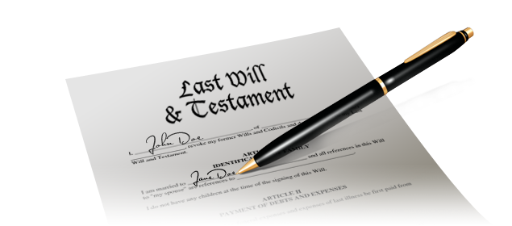
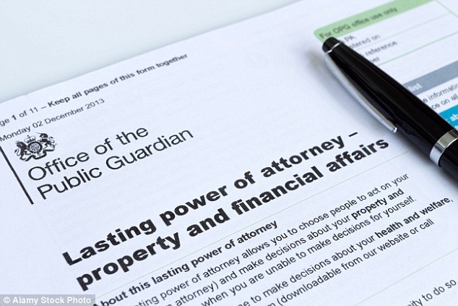
What we do
TRUST
&
WILL
LPA
Notes:
Three documents that can be created to ensure your wishes are carried out
Wills
Trusts – Will Trusts / Lifetime Trusts
LPAs
CoP and Deputyship Applications

Slide 6
What we really do!
Put you in control of:
Ultimate destination of your wealth
Who can make decisions when someone cannot
We help you to minimise disinheritance threats
And maximise inheritance
Protect Vulnerable Beneficiaries
Result: complete peace of mind / make life easier for loved ones

Slide 7
How we work with you
Home visits
Convenient time/day
Identify your concerns and objectives
Explain your options / jargon free “plain English”
Bespoke recommendations
You decide

Slide 8
What is a Vulnerable Beneficiary?
Any person, young or old, who is unable to manage their own affairs, take care of or protect themselves
Vulnerability increases massively once parents have passed away
Therefore, the need to plan ahead now is essential
Notes:
Definition:
“Vulnerable beneficiary/adult: a person aged 18 or over who is or maybe in need of community care services by reason of mental or other disability, age or illness, and who is or may be unable to take care of himself or herself, or unable to protect himself or herself against significant harm or exploitation.”
Prior to 18 parents have parental responsibility.
Particularly important after parents have passed away.

Slide 9
Vulnerable Beneficiaries
Our experience from last 5 years
We’ve met thousands of people at: -
Autism Shows
Autism Talks events
Parent/carer and school talks
We hear two things all the time:
“We were told there was nothing we could do”
2. “We don’t know where to go to get help & advice”

Slide 10
Vulnerable Beneficiaries
The “Inheritance Pot”
What is the “Inheritance Pot”?
The “Inheritance Pot” is the wealth (inheritance) you HOPE to leave after you have passed away but …
Why is it so important?
The “Inheritance Pot” MUST be as large as possible to provide long-term financial support

Slide 11
Q. How big do you want the
“Inheritance Pot” to be?

Slide 12
Estate Planning for Vulnerable Beneficiaries
The three key factors are: -
You must maximise YOUR inheritance
You must maximise THEIR inheritance
You must protect THEIR inheritance (long-term)
Notes:
Definition:
“Vulnerable beneficiary/adult: a person aged 18 or over who is or maybe in need of community care services by reason of mental or other disability, age or illness, and who is or may be unable to take care of himself or herself, or unable to protect himself or herself against significant harm or exploitation.”
Prior to 18 parents have parental responsibility.
Particularly important after parents have passed away.

Slide 13
Vulnerable Beneficiaries
How to maximise the “Inheritance Pot”
1. First you must protect YOUR inheritance from loss as a result of: -
(i) Sideways Disinheritance
(ii) Local Authority care fees
(iii) Other disinheritance threats; probate, tax, divorce, creditors etc.

Slide 14
Vulnerable Beneficiaries
How to maximise the “Inheritance Pot”
2. Second, you must protect THEIR inheritance from loss as a result of: -
(i) Sideways Disinheritance
(ii) Local Authority care fees
(iii) Other disinheritance threats; probate, tax, divorce, creditors etc.

Slide 15
Threats To Maximising
“the Inheritance Pot”
The way you own your home is critical to maximising inheritance
Only two ways
Joint ownership vs TIC

Slide 16
Couple with joint assets
1. Joint ownership The problem = the law
Main asset probably your home
Both own 100% of the property
Ownership passes automatically to survivor on first death
Your Will/Intestacy are irrelevant
You have NO CONTROL
This has two major implications
Notes:
Make mirror wills: on first death all assets remain with the surviving spouse

Slide 17
Joint ownership – Sideways Disinheritance
Survivor now owns the 100% of the property, but risk of disinheritance due to
Sideway disinheritance – if the survivor
Remarries
Makes no Will
Makes the wrong Will
Owns property jointly with new spouse/partner
Property ends up going sideways to the new spouse or partner, down the wrong bloodline and disinheriting your beneficiaries
Notes:
Make mirror wills: on first death all assets remain with the surviving spouse

Slide 18
Joint ownership – Care Fees
Survivor now owns the whole property, but major risk of loss due to
Long-term care fees - if the survivor goes into care
Problem is the limits – haven’t changed for many years
Notes:
Make mirror wills: on first death all assets remain with the surviving spouse

Slide 19
What are the limits for Long-Term Care?
Upper Limit £23,250 100% tax above £23,250
Middle Band £14,250 - £23,250
Lower Limit £14,250 All you are left with!
Notes:
People complain about inheritance tax, but at least the first £325k is not taxed and the balance is only taxed at 40%!
If you have more than £23,250 of assets you must pay care fees in full
Between £14,250 and £23,250, fees will be calculated on a sliding scale
Below £14,250 you don’t have to pay.
It is easy to see why people might want to legitimately mitigate care fees

Slide 20
What’s the problem with care fees
Cost over 3-4 years = £150,000 to £200,000
Every year about 70,000 people are forced to sell their home
Average care home bills - £1,000 per week
Typical stay – 3-4 years
Notes:
You can see why so many people are concerned about long term care fees.

Slide 21
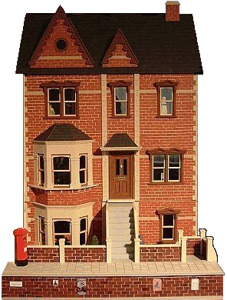
Protecting your biggest asset
This is a joint tenancy
Both parties own 100% of the property
On death – you have no control
Survivor now owns 100%
100% at risk of sideways disinheritance
100% at risk from care fees
So what options do we have?

Slide 22
Protecting your biggest asset
Change ownership to tenants in common
Each party now owns 50% of the property
Now on first death
The first to die makes a gift to a Life Interest Will Trust protecting the survivor for life
The survivor is still in control of the property, no rent, can move etc.
BUT 50% of the property is now ring-fenced for beneficiaries

Slide 23
Protecting your biggest asset
Change ownership to tenants in common
Each party now owns 50% of the property
Now on first death
50% of property cannot go sideways to a new spouse or partner
50% of property is ring-fenced and cannot be assessed by Local Authority for care fees if survivor goes into care
BUT only 50% of property is protected!
BUT probate still needed - ~£10k/12 months
BUT “what ifs”

Slide 24
Protecting all your assets
Lifetime Trusts are the key to effective
estate planning
By transferring your assets into a trust now: -
You can protect all your wealth against
all threats during your lifetime
AND
You can protect your wealth and your
beneficiaries long-term
Lifetime Trust

Slide 25
Principal benefits of a Lifetime Trust
Maximises inheritance by avoiding: -
Sideways disinheritance - protects 100% of your home
Probate costs average £10,000
Probate delays of 12 months +
Beneficiaries disinheritance in event of:
Loss of benefits
Divorce
Insolvency
IHT
Unreliability
Challenges
Care*

Slide 26
Vulnerable Beneficiaries
How to protect the “Inheritance Pot”
Protect the Vulnerable Beneficiary's “Inheritance Pot” from 3 major threats: -
The Vulnerable Beneficiary
Unscrupulous Third Parties
Loss of Means Tested Benefits

Slide 27
Specific threats for Vulnerable Beneficiaries
Protection may be needed against wasting an inheritance:
Self
Notes:
There are three specific estate planning threats for vulnerable beneficiaries: -
FIRST protection against self – wasting inheritance on fast cars, tech gadgets etc.

Slide 28
Specific threats for Vulnerable Beneficiaries
Protection may be needed against others:
Financial abuse by unscrupulous third parties
Notes:
Vulnerable beneficiaries also need protecting from unscrupulous 3rd parties
Particularly IF they inherit directly because you have no Will or the wrong Will

Slide 29
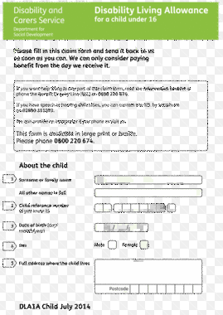
Specific threats for Vulnerable Beneficiaries
Protection IS needed against:
Loss of means tested benefits
Assets held in trust are NOT means tested
Notes:
And finally
As little as £6,000 can affect the benefits they receive
Number 3 is protection against loss of means tested benefits

Slide 30
Solutions: Estate Planning
for Vulnerable Beneficiaries
Wills:
An appropriate Will is essential: -
But is only the starting point
Can only distribute your estate
Can only distribute what’s left of your estate on second death
Common pitfalls/mistakes:

Slide 31
Common pitfalls to avoid: -
Not make a Will
Exclude – I(PFD) Act 1975
Leave to a sibling to “look after” child
Leave absolutely to vulnerable beneficiary
ALL – result from not getting the right advice
Notes:
People don’t know what to do
People do what they think is right without getting proper advice
Taking action without getting good advice can be disastrous
EXCLUDE - Will excludes VB & leave money to other children who will look after them.
Social services can challenge the Will for non-provision = costs/delays.
SIBLING but what if bankruptcy or divorce
TO VB Means tested benefits – start to lose benefits with as little as £6,000
Need deputyship order ~ about £2,500 to £3,000
Can be avoided

Slide 32
Solutions: Estate Planning
for Vulnerable Beneficiaries
Trusts:
Vulnerable Beneficiary Trusts are specifically designed to protect an inheritance against: -
Wasting Inheritance; can drip feed money as needed
Financial Abuse; trustees in control of distributing money
Loss of Means Tested Benefits; not part of beneficiary’s estate

Slide 33
Other issues for Vulnerable Beneficiaries
Financial decisions: -
Ability to make sound decisions
Appointee for benefits vs LPA P&FA vs Deputyship Application
Personal decisions: -
Ability to make sound decisions
Best interest assessment vs LPA H&W vs Deputyship Application

Slide 34
Getting the right legal advice – you should
Choose someone experienced and STEP qualified
Identify your objectives clearly
Consider all your options and choose what’s right for you and your family

Slide 35
How we work with you
We aim to make the process easy, convenient and affordable: -
Home visits at convenient time/day (*Covid dependent)
No obligation or fee – just a cup of tea
Identify your concerns and objectives
Explain your options / jargon free “plain English”
Appropriate recommendations
You decide what’s best for you & your loved ones

Slide 36
Our 3 Aims
Identify specific legal / financial problems
Provide advice in relation to your options / solutions
Provide guidance on how to get the right help and advice

Slide 37
Thank you for listening – Any questions?
Other help - Useful Fact Sheets: -
VB1 – General Information and Useful Contacts
VB2 – Wills and Trusts
VB3 - Guardianship
VB4 – Making Financial Decisions
VB5 – Making Personal Decisions
Please call 0800 781 6658 or email info@estplan.co.uk

